Slide 1
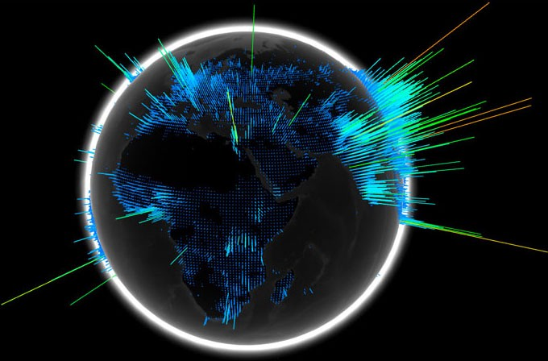
Transit application
Term name :
bite N bytes Coders: kali kousik.t
Theme: asHwin kumar.m
transportation track anglesvar a.c
guru sankar . s

Slide 2

Introduction with problem statement
GTFS – General Transit Feed Specification
An application to provide various transit feeds and schedules of transportation. Use GPRS to track the modes of transportation to provide users a clear view of the transport system.

Slide 3

Tools used in
Android Studio
Firebase
Railway API
Bus Transit Feed

Slide 4

Transit view..
This application will completely track the common user’s travel by supporting with many mode of transports like bus, train etc..
Transit starts like a normal booking application that are available in google play services but this application will suggest you the mode of transport which is minimum in cost and fast moving transportation by getting the location of you are in and the location you want to go

Slide 5

Transit has …
The Transit will keep tracking you so that the application will give you the alert notification when the bus is near the stop when the user is not near the stop
The application Transit will match the co-ordinated of the bus and the user and verify that user are boarded into the bus

Slide 6

The traveling location of the user can be viewed with this application
The linked account can track the live location user account
Until the user step down from the bus the Transit fellows them

Slide 7
conclusion
Using multiple application for traveling and application cannot help user in exception time can be completely overcome…
Transit will set a new way of application and user communication …
Development of optimisation and efficiency are in progress
Thank You
Term Bite N Byte

